Slide 1
操作系统概念
Operating System Concepts
Silberschatz, Galvin and Gagne
王冬青
wang.box@163.com

Slide 2
内容框架
概述
体系结构
进程管理
内存管理
文件管理
外设管理

Slide 3
内容
Ch2: 计算机体系结构
Ch3: 操作系统体系结构

Slide 4
Ch2：硬件体系结构
机械计算机/器
现代计算机（可存储式）
材料（物理学）
  电子管（真空管）
  晶体管
  集成电路IC
应用爆发点
  PC
  互联网
  移动
  AI

Slide 5
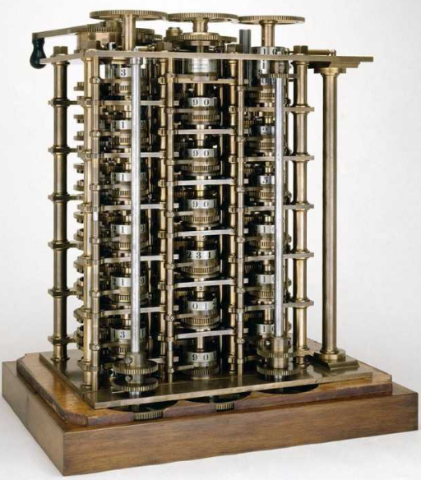
机械式

Slide 6
Ch2：硬件体系结构
冯·诺依曼(普林斯顿结构)
哈佛结构
拓展：（通用）图灵机；计算机之父？

Slide 7
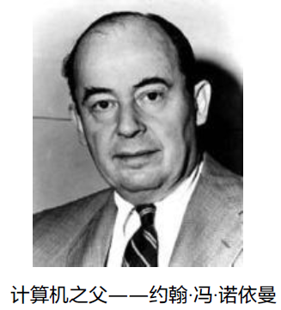
Ch2：硬件体系结构
冯·诺依曼(普林斯顿结构)
哈佛结构

Slide 8
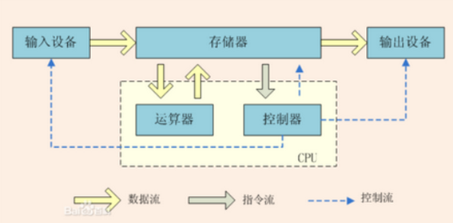
冯·诺依曼结构
特点：
一个存储器（数据和指令在一个存储器里）；
一个控制器；
一个运算器，用于完成算术运算和逻辑运算；
输入和输出设备，用于进行人机通信。

Slide 9
Ch2：硬件体系结构
冯·诺依曼(普林斯顿结构)
哈佛结构

Slide 10
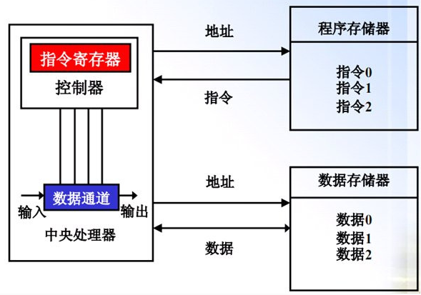
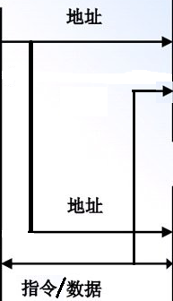
哈佛结构
总线改进型
特点：
数据和指令分开存储;
指令和数据可以有不同的宽度；
可以并行存取，具有较高的效率；

Slide 11
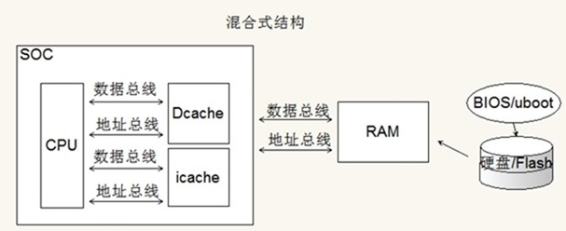
混合结构

Slide 12
Ch2：硬件体系结构
Modern computer system structure
I/O Structure
Storage Structure
Hardware Protection

Slide 13
Ch2：硬件体系结构
Modern computer system structure
I/O Structure
Storage Structure
Hardware Protection

Slide 14
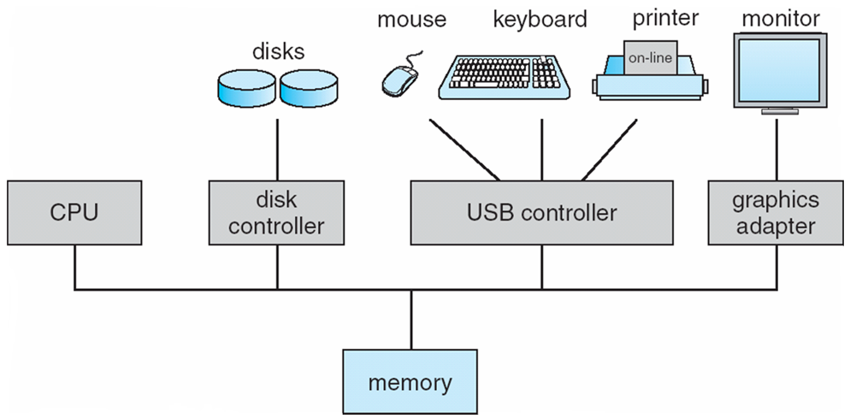
Modern computer system structure
拓展：计算机的启动过程
1 x86 ；2 RISC-V
现代计算机体系结构

Slide 15
Modern computer
system structure
The CPU and I/O devices can execute concurrently
CPU
  fetches a instruction and executes it.
  moves data from/to main memory to/from local buffers.
Device controller
  is in charge of a particular device type.
  has a local buffer. I/O is from the device to local buffer of controller.
  informs CPU that it has finished its operation by causing an interrupt.
并发性

Slide 16
Ch2：硬件体系结构
Modern computer system structure
I/O Structure
Storage Structure
Hardware Protection

Slide 17
I/O Structure
Two I/O methods
  Synchronous — 同步
  Asynchronous — 异步
I/O technology
  Program I/O — 程序IO
  Interrupt — 中断
  DMA — 直接存储器访问
  Channel — 通道

Slide 18
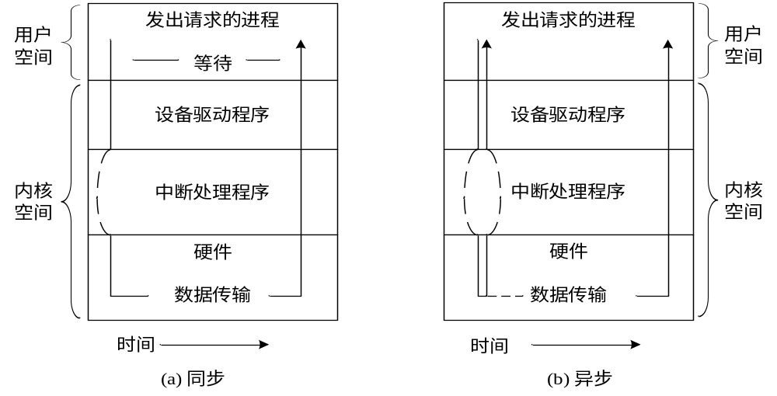
Two I/O methods
Synchronous
Asynchronous

Slide 19
Synchronous I/O
After I/O starts, control returns to user program only upon I/O completion.
How to wait for I/O completion:
  wait instruction idles the CPU until the next interrupt
  wait loop (contention for memory access).
If the CPU always waits for I/O completion, at most one I/O request is outstanding at a time. Thus, whenever an I/O interrupt occurs, the OS knows exactly which device is interrupting.(一次只能处理一个中断)
This approach excludes concurrent I/O operations to several devices, and also excludes the possibility of overlapping useful computation with I/O.（无法并发执行）

Slide 20
Asynchronous I/O
After I/O starts, control returns to user program without waiting for I/O completion.
  System call – request to the operating system to allow user to wait for I/O completion.
  Device-status table contains entry for each I/O device indicating its type, address, and state.
  Operating system indexes into I/O device table to determine device status and to modify table entry to include interrupt.

Slide 21
I/O technology
  Program I/O — 程序IO
  Interrupt— 中断
  DMA— 直接存储器访问
  Channel— 通道

Slide 22
I/O technology
Program I/O
  处理器提供I/O相关指令实现
  处理器定期轮询I/O单元的状态，直到处
  理完毕
  存在问题：占用cpu时间

Slide 23
I/O technology
Interrupt
  解决PIO技术中的问题，让处理器从轮询任务中解放出来，使I/O操作和指令执行并行起来。
  具体做法
当I/O处理单元准备好与设备交互的时候，
通过物理信号通知中断处理器，再有其判断、仲裁后决定是否提交CPU。

Slide 24
中断机制
An operating system is interrupt driven
  Interrupt transfers control to the interrupt service routine(ISR) generally, through the interrupt vector, which contains the addresses of all the service routines.
  Interrupt architecture must save the address of the interrupted instruction.
  Incoming interrupts are disabled while another interrupt is being processed to prevent a lost interrupt.
  A trap is a software-generated interrupt caused either by an error or a user request.

Slide 25
中断机制
Interrupt handling
  The operating system preserves the state of the CPU by storing registers and the program counter（PC）.
  Determines which type of interrupt has occurred:
    polling
    vectored interrupt system.
  Separate segments of code determine what action should be taken for each type of interrupt.
  Returns to the saved state or other parts of OS.

Slide 26

中断机制
单个进程执行输出的中断时间线路

Slide 27
I/O technology
DMA
  中断的引入大大地提高了处理器处理I/O的效率，但是效率仍旧不高。
  解决方法：直接存储器访问（DMA）
通过系统总线中独立控制单元——DMA控制器， 自动控制成块数据在内存和I/O单元间的传送，大大提高处理I/O的效能。

Slide 28
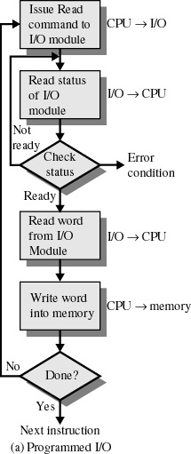
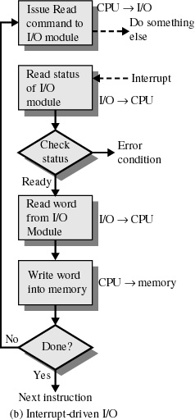
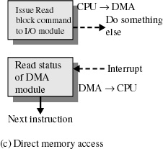
中断I/O
DMA
程序I/O

Slide 29
I/O technology
Channel（通道）
  独立于中央处理器，专门负责数据I/O传输的处理机（I/O处理机），由专门通道指令编写的的软件进行管理
  引入通道的目的
    使CPU从I/O事务中解脱出来
    同时为了提高CPU与设备、设备与设备之间的并行度
  优点：
    独立性比DMA强
    能对多台不同类型的设备统一管理，对多个设备同时传送信息

Slide 30

I/O technology

Slide 31
Ch2：硬件体系结构
Modern computer system structure
I/O Structure
Storage Structure
Hardware Protection

Slide 32
Storage Structure
Storage Hierarchy — 存储层次
Main memory — 主存
Secondary storage — 辅存
Caching — 缓存

Slide 33
Storage Structure
Storage Hierarchy
Main memory
Secondary storage
Caching

Slide 34
Storage Hierarchy
Storage systems organized in hierarchy.
  Speed
  Cost
  capacity
  volatility
The design of a complete memory system must balance all these factors:
  It uses only as much expensive memory as necessary,
  while providing as much inexpensive, nonvolatile memory as possible.

Slide 35

Storage-Device Hierarchy

Slide 36
Level | 1 | 2 | 3 | 4 | 5
Name | registers | cache | main memory | solid state disk | magnetic disk
Typical size | < 1 KB | < 16 MB | < 64 GB | < 1 TB | < 10 TB
Implementation technology | custom memory with multiple ports CMOS | on-chip or off-ship CMOS SRAM | CMOS DRAM | flash memory | magnetic disk
Access time (ns) | 0.25 to 0.5 | 0.5 to 25 | 80 to 250 | 25,000 to 50,000 | 5,000,000
Bandwidth (MB/sec) | 20,000 to 100,000 | 5,000 to 10,000 | 1,000 to 5,000 | 500 | 20 to 150
Managed by | compiler | hardware | operating system | operating system | operating system
Backed by | cache | main memory | disk | disk | disk or tape

Slide 37
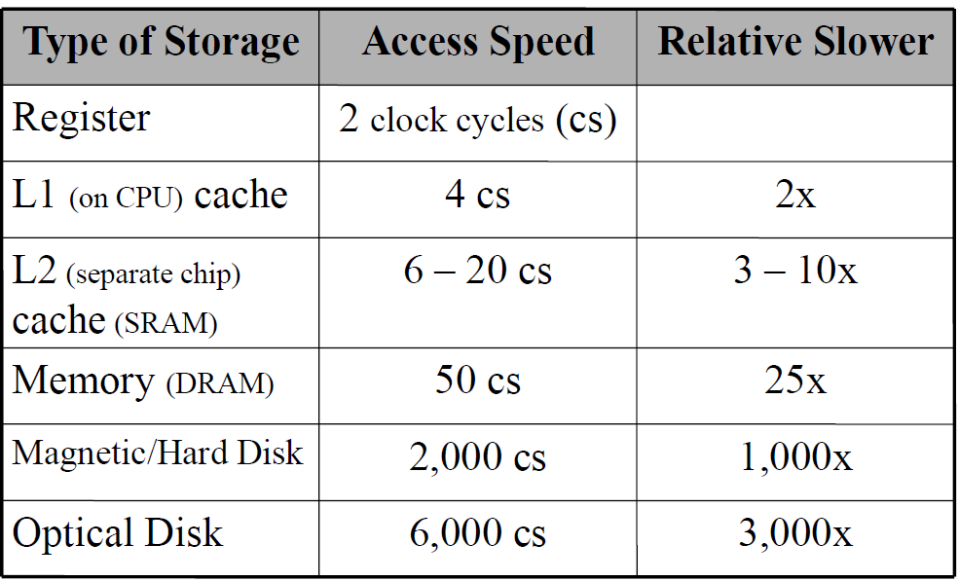
Storage Hierarchy’s Speed
L0

Slide 38
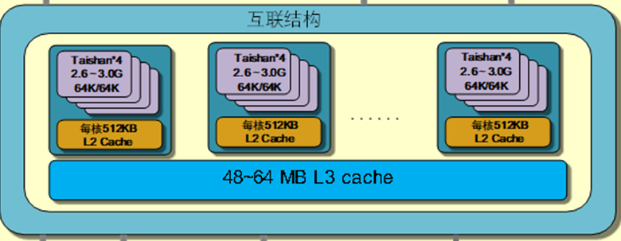
Storage Hierarchy’s Speed
L1
鲲鹏920Cache结构：
L1：独立的指令/数据缓存
L2：每个核内部
L3：多核共享

Slide 39
Storage Structure
Storage Hierarchy
Main memory
Secondary storage
Caching

Slide 40
Main memory
only large storage media that the CPU can access directly.
  两种原因导致程序和数据不能长期驻
  留内存：
1. 内存大小有限；
2. 内存是易失性存储设备；
所以需要辅助存储器（secondary storage）对内存进行扩充。

Slide 41
Storage Structure
Storage Hierarchy
Main memory
Secondary storage
Caching

Slide 42
Secondary storage
对主存容量的扩展
信息的永久保存
本地+远程

Slide 43
Secondary storage
Extension of main memory that provides large nonvolatile storage capacity.
  Magnetic disks
  Disk surface is logically divided into tracks, which are subdivided into sectors.
  The disk controller determines the logical interaction between the device and the computer.

Slide 44

  Magnetic disks Structure

Slide 45
Storage Structure
Storage Hierarchy
Main memory
Secondary storage
Caching

Slide 46
Caching
Caching
copying information into faster storage system; main memory can be viewed as a last cache for secondary storage.

Slide 47
Caching
缓冲三种位置（硬件层面的）
  处理器与主存储器之间
  处理器和其它外部设备之间
  设备与设备之间的通信
目的
解决部件之间速度不匹配的问题

Slide 48
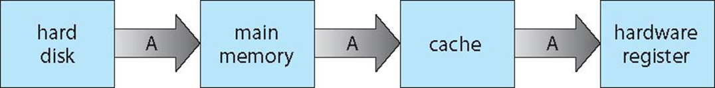
Consistency
存储系统的数据一致性

Slide 49
Ch2：硬件体系结构
Modern computer system structure
I/O Structure
Storage Structure
Hardware Protection

Slide 50
Hardware Protection
Dual-Mode Operation — 双工作模式
I/O Protection — IO保护
Memory Protection — 内存保护
CPU Protection — CPU 保护

Slide 51
Hardware Protection
Dual-Mode Operation
  Sharing system resources requires operating system to ensure that an incorrect program cannot cause other programs to execute incorrectly.

Slide 52
Hardware Protection
  Provide hardware support to differentiate between at least two modes of operations.
    1.User mode – execution done on behalf of a user.
    2.Monitor mode (also supervisor mode or system mode) – execution done on behalf of operating system.

Slide 53
Hardware Protection
Mode bit added to computer hardware to indicate the current mode: monitor (0) or user (1).
Interrupt/fault
monitor
user
set user mode

Slide 54
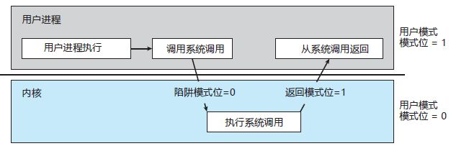
Hardware Protection
用户模式到内核模式的切换
拓展：x86的实模式和保护模式

Slide 55
Hardware Protection
Privileged instructions（特权级指令） can be issued only in monitor mode.
When an interrupt or fault occurs hardware switches to monitor mode.
哪些属于特权级指令？

Slide 56
Hardware Protection
I/O Protection
  All I/O instructions are privileged instructions.
  Must ensure that a user program could never gain control of the computer in monitor mode (I.e., a user program that, as part of its execution, stores a new address in the interrupt vector).

Slide 57
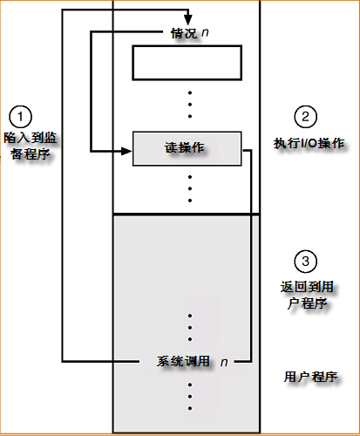
Use of A System Call to Perform I/O

Slide 58
Hardware Protection
Memory Protection
  Must provide memory protection at least for the interrupt vector and the interrupt service routines.
  In order to have memory protection, add two registers that determine the range of legal addresses a program may access:
    base register – holds the smallest legal physical memory address.
    Limit register – contains the size of the range
  Memory outside the defined range is protected.

Slide 59

Hardware Protection
Use of A Base and Limit Register

Slide 60

Hardware Protection
Hardware Address Protection
When executing in monitor mode, the operating system has unrestricted access to both monitor and user’s memory.
The load instructions for the base and limit registers are privileged instructions.

Slide 61
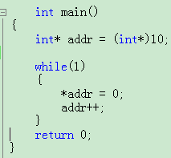
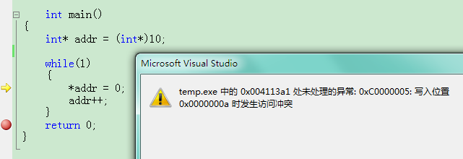
Hardware Protection

Slide 62
Hardware Protection
CPU Protection
  Timer – interrupts（定时器中断） computer after specified period to ensure operating system maintains control.
  To use the timer to prevent a user program from running too long
    To initialize a counter with the amount of time that a program is allowed to run.
    Timer is decremented every clock tick.
    When timer reaches the value 0, an interrupt occurs.
  Timer commonly used to implement time sharing.
  Time also used to compute the current time.
  Load-timer is a privileged instruction.（读定时器指令是特权级吗？）

Slide 63
小节
了解计算机体系结构★ ★
I/O方式★ ★
存储机制★ ★ ★
保护机制★ ★ ★

